Slide 1
SATs Information March 2024 SATs is a term used to refer to End of Key Stage 2 Assessments

Slide 2
What will your child be tested on?
The SATs (Standard Assessment Tests)
will take place during the week commencing
Monday 13th May 2024.
Reading
Maths
Grammar
Spelling

Slide 3
Maths – 3 papers

Slide 4
Maths – Additional information
Paper 1 covers calculation methods for all operations, including use of fractions, percentages and decimals.
Questions gradually increase in difficulty. Not all children will be expected to access some of the more difficult questions later in the paper.
30 minutes to answer 36 question – about 1 minute per question!
Papers 2 and 3 cover ‘Problem Solving and Reasoning’.
Pupils will still require calculation skills but will need to answer questions in context and decide what is required to find a solution.

Slide 5
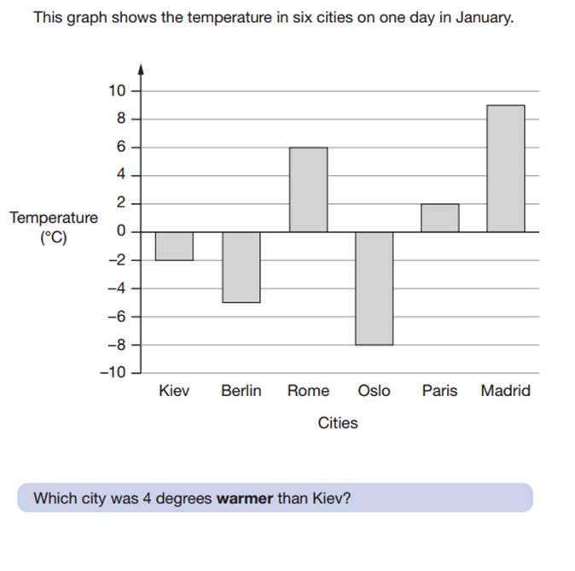
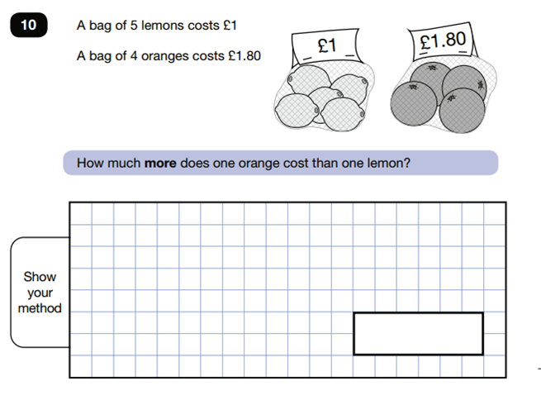
Sample Maths Questions

Slide 6
English – 3 papers
Reading
Grammar & Punctuation
Spelling

Slide 7
Reading – Children need to manage their time and become very good at skimming and scanning.

Slide 8
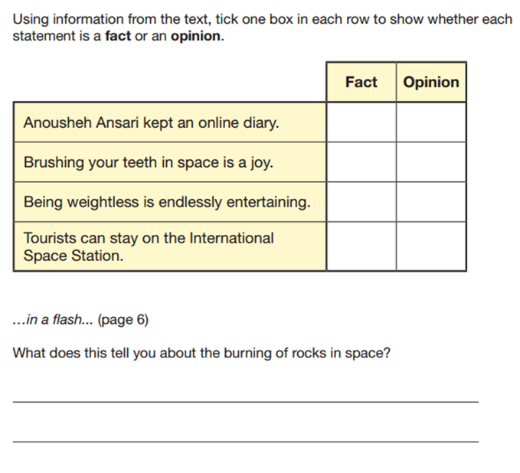
Sample Reading Questions

Slide 9
Grammar, punctuation and spelling
Marks will be deducted if sentences are not punctuated with full stops and capitals or if the capital letter does not look like a capital letter!
If capital letters are wrongly included, they will also not receive a mark for that answer.
Upper and lower case letters must be clear.

Slide 10
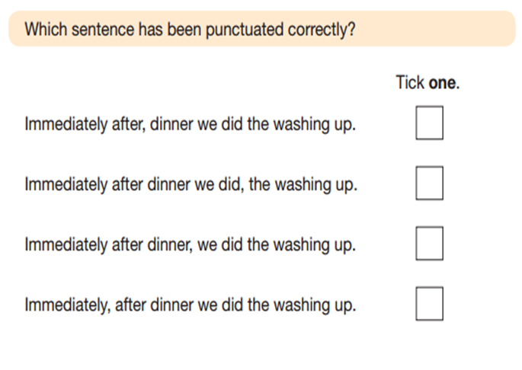
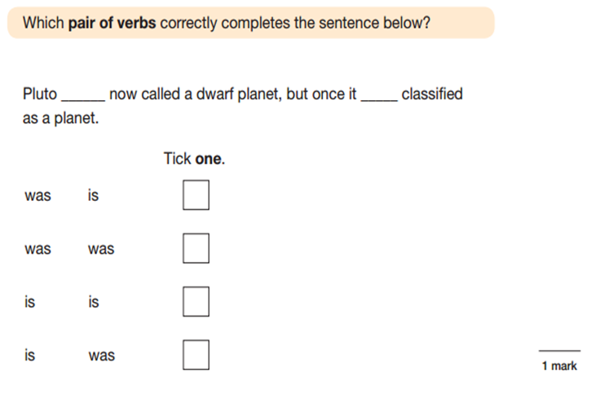
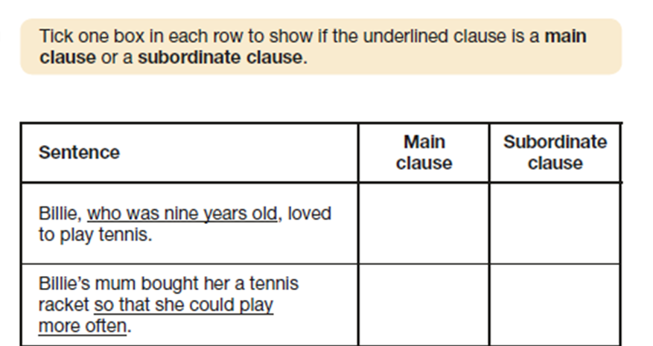
Sample SPAG Questions

Slide 11
Spelling – 20 spellings read out.
Give the spelling number
Say: The word is…
Read the word in the context of the sentence
Repeat: The word is…
Example:
Spelling 1: The word is discover.
Sara wanted to be an explorer and discover new lands.
The word is discover.

Slide 12
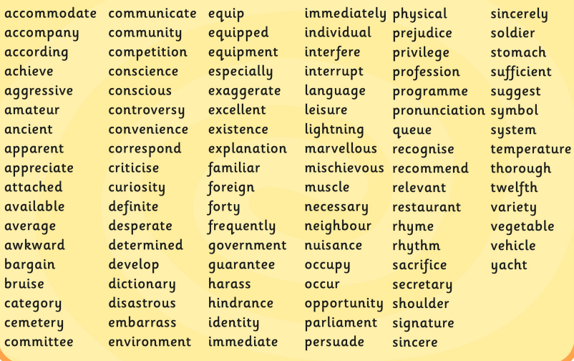
Spelling List

Slide 13
Test scores
Once marked, the tests will be given the following scores:
A raw score (the total number of marks achieved for each paper);
A scaled score;
A judgement of whether the National Standard has been met.
After marking each test, the external markers will convert each raw score into a scaled score to show whether each child is working below, at or above the national standard.
When the scaled score is given, it is given in a range from 80 to 120.
A scaled score of 100 or more is meeting the national standard.
There are no separate tests for higher achieving pupils; however, a scaled score above 110 would show that a child is working above the national standard.

Slide 14
Scaled score examples:
A child awarded a scaled score of 100 is judged to have met the
‘national standard’ in the area judged by the test.
A child awarded a scaled score of more than 110 is judged to have
exceeded the national standard and demonstrated a higher than
expected knowledge of the curriculum for their age.
A child awarded a scaled score of less than 100 is judged to have not
yet met the national standard and performed below expectation
for their age.

Slide 15
How to help your child
First and foremost, support and reassure your child that there is nothing to worry about and they should always just try their best. Praise and encourage!
Ensure your child has the best possible attendance at school.
Support your child with any homework tasks – CGP books, SATs Bootcamp and additional tasks.
Reading, spelling and arithmetic (e.g. times tables - TTRS) are always good to practise.
Talk to your child about what they have learnt at school and what book(s) they are reading (the character, the plot, their opinion).
Make sure your child has a good sleep and healthy breakfast every morning!

Slide 16
How to help your child with reading
Listening to your child read can take many forms.
First and foremost, focus on developing an enjoyment and love of reading.
Enjoy stories together – reading stories to your child at KS2 is equally as important as listening to your child read.
Read a little at a time but often, rather than rarely but for long periods of time!
Talk about the story before, during and afterwards – discuss the plot, the characters, their feelings and actions, how it makes you feel, predict what will happen and encourage your child to have their own opinions.
Look up definitions of words together – you could use a dictionary, the internet or an app on a phone or tablet.
All reading is valuable – it doesn’t have to be just stories. Reading can involve anything from fiction and non-fiction, poetry, newspapers, magazines, football programmes, TV guides.
Visit the local library - it’s free!

Slide 17
How to help your child with maths
Play times tables games
Play mental maths games including counting in different amounts, forwards and backwards.
Encourage opportunities for telling the time.
Encourage opportunities for counting coins and money; finding amounts or calculating change when shopping.
Look for examples of 2D and 3D shapes around the home.
Identify, weigh or measure quantities and amounts in the kitchen or in recipes.
Play games involving numbers or logic, such as dominoes, card games, darts, draughts or chess.

Slide 18
How to help your child with writing
Encourage opportunities for writing such as letters to family or friends, shopping lists, notes or reminders, stories or poems and e-mails.
Write together – be a good role model for writing.
Encourage use of a dictionary to check spelling and a thesaurus to find synonyms and expand vocabulary. Correct spellings together.
Allow your child to use a computer for word processing, which will allow for editing and correcting of errors without lots of crossing out.
Remember that good readers become good writers! Identify good writing features when reading (e.g. vocabulary, sentence structure, punctuation).
Show your appreciation: praise and encourage, even for small successes!

Slide 19
SATs at Branfil
We want your child to take them seriously but do not want them to panic.
We will provide your child with the best possible opportunity to reach their potential so there will be lots of practice tests, working to time frames etc.
Your child may be given extra support in the run up to SATs in Reading, Writing or Maths.
Please support your child in completing their homework each week – CGP books
Year 6 is not just about SATs, everything that is taught is to make sure your child is ready for Secondary school.

Slide 20
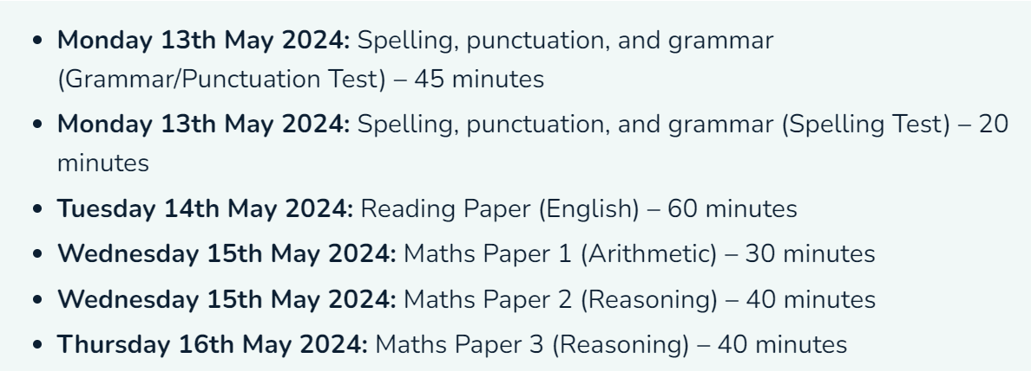
Timetable

Slide 21
Thank you
We look forward to working with you to ensure your child reaches their goals for the end of this academic year.
Please email is if you have any additional questions
year6@branfil.havering.sch.uk
Useful link:
http://www.satspapers.org.uk/Page.aspx?TId=5
PLEASE DO NOT DO THE 2023 PAPERS – Thank you!

