Slide 1
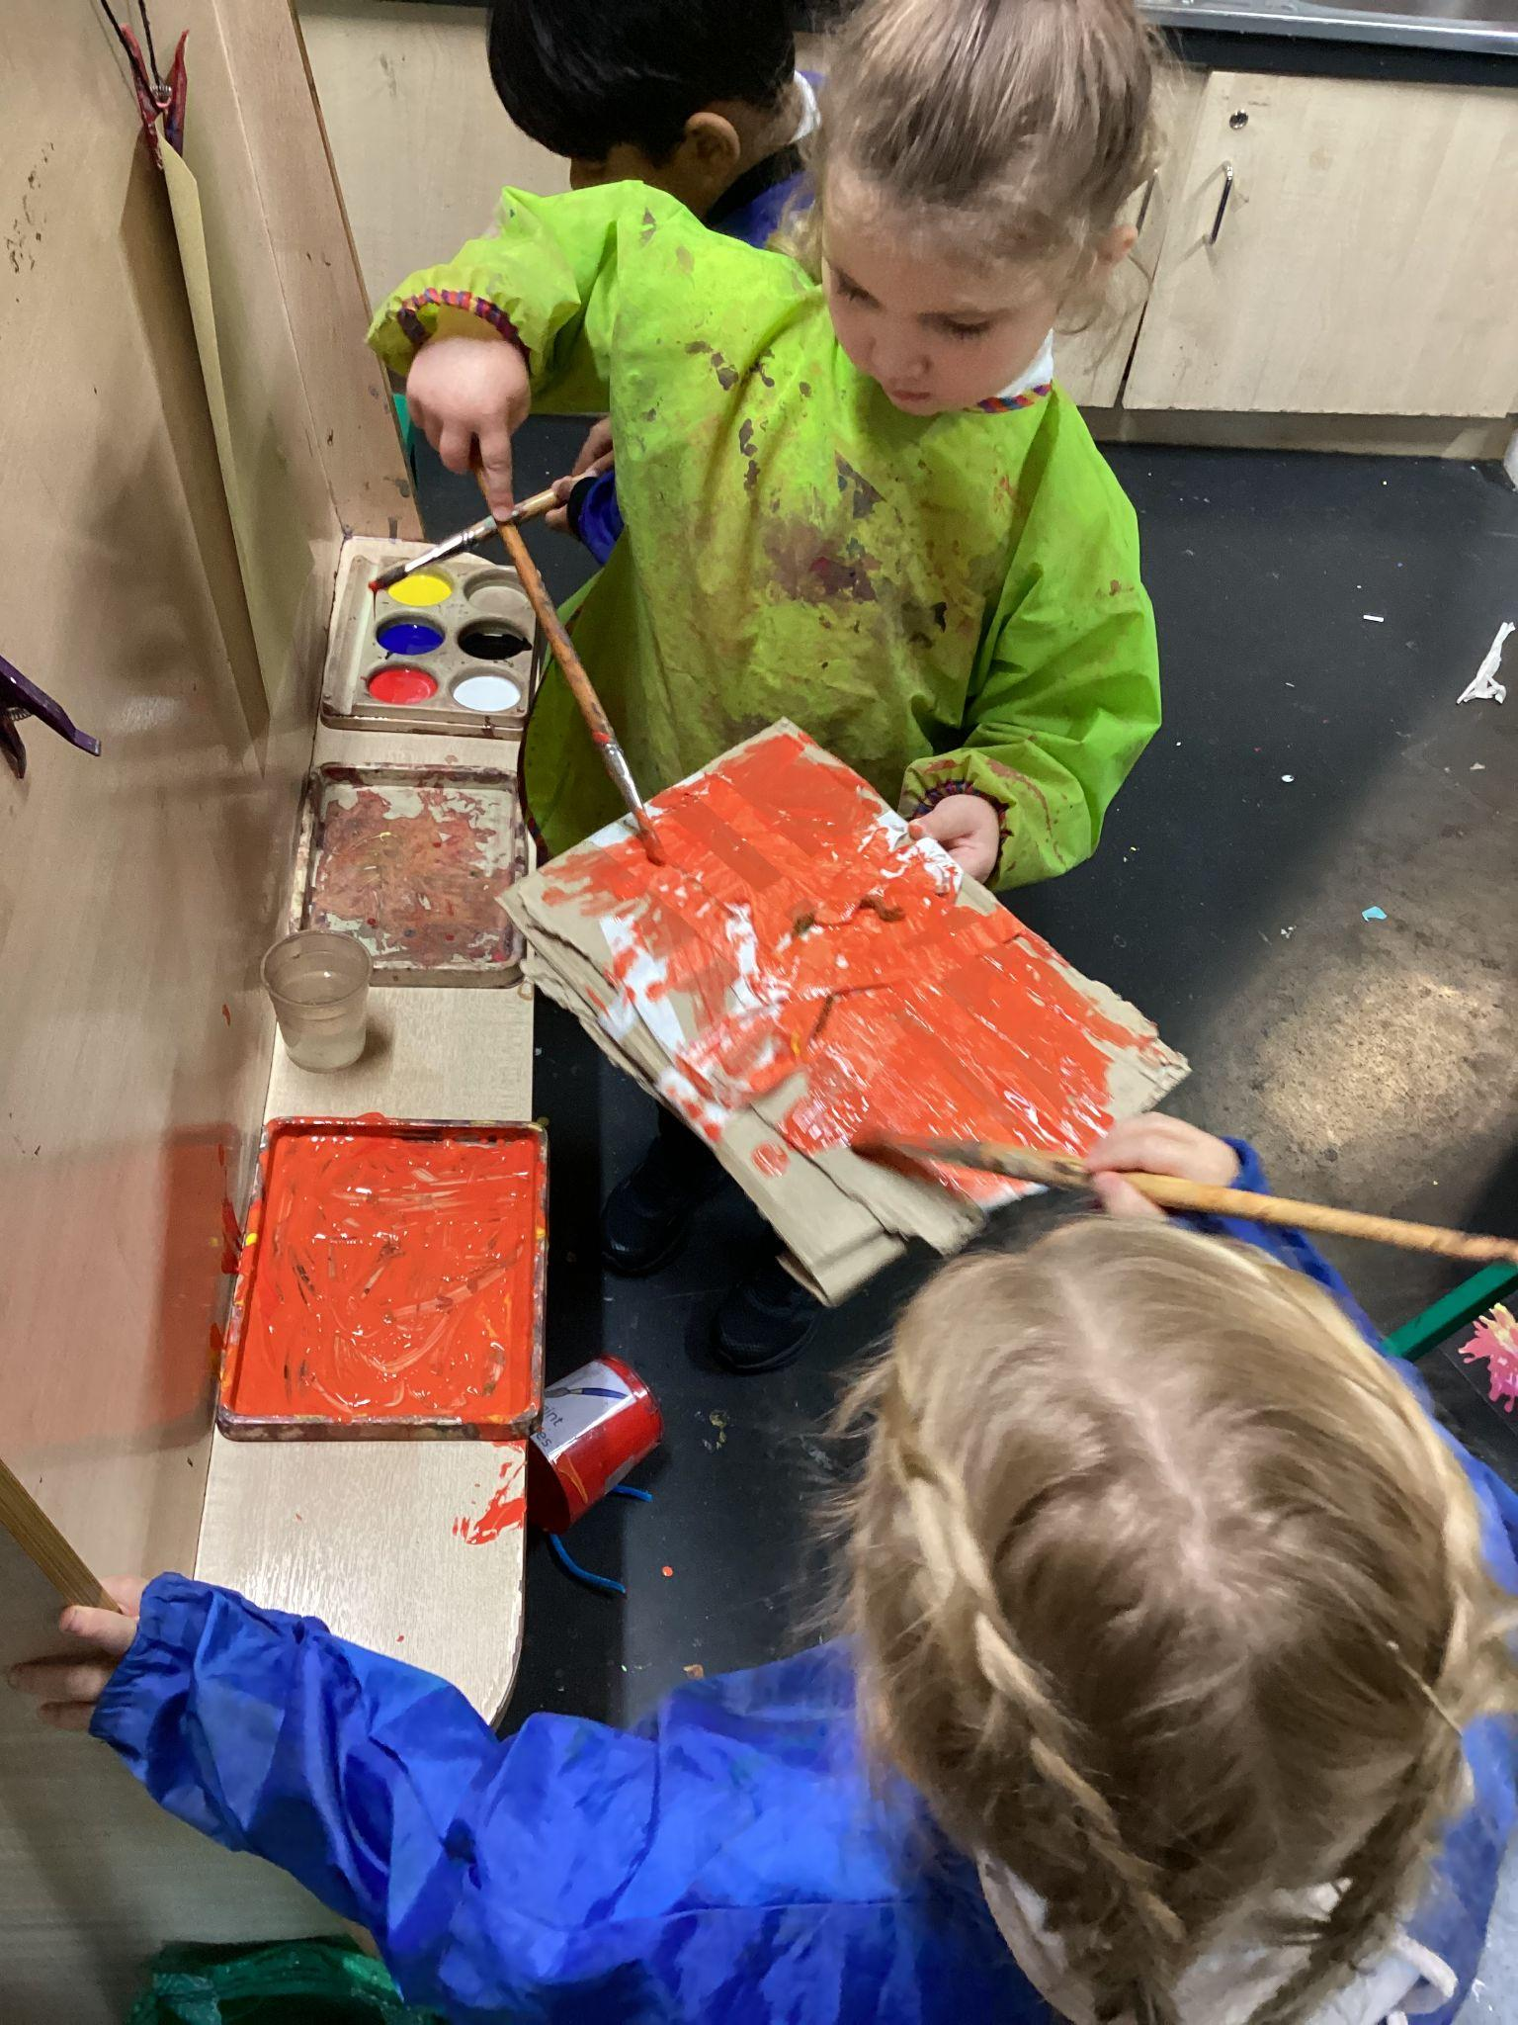
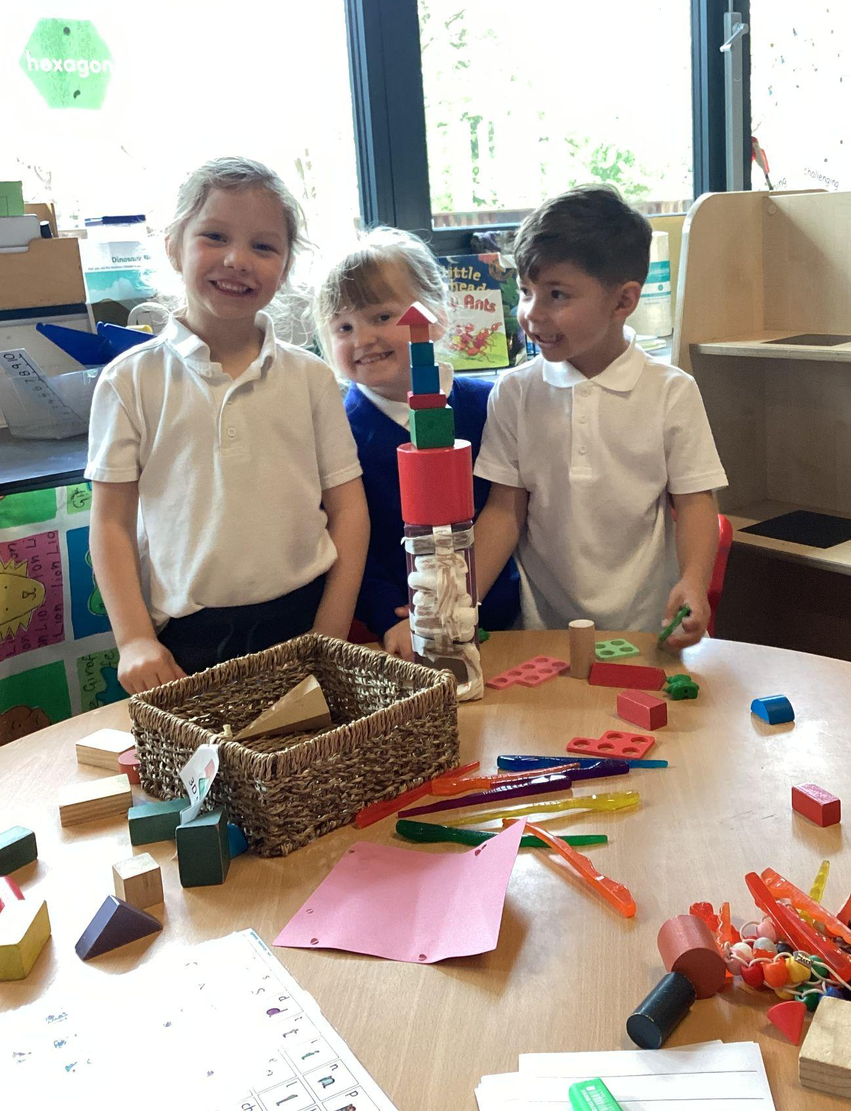
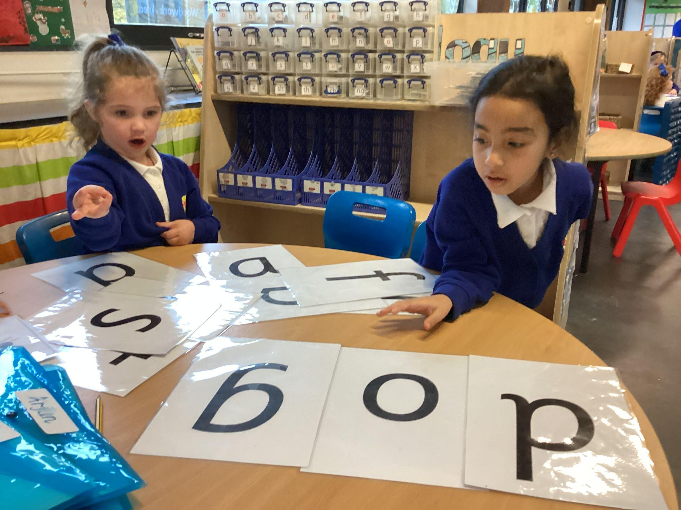
Welcome
Parent/Carer New Intake Information Meeting May 2024
Mrs Gunthorpe and Mrs Gafford

Slide 2
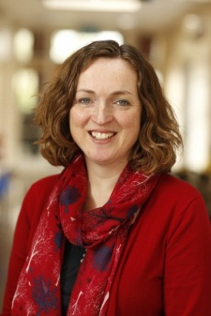
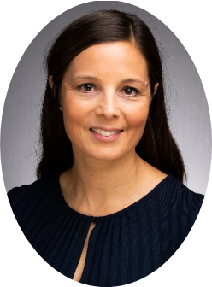
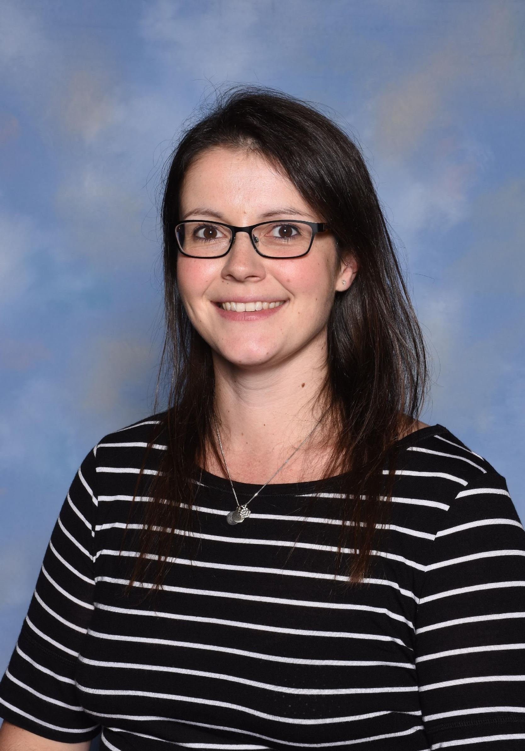
Staff
Mrs Sansom
Headteacher
Mrs Gunthorpe
Deputy Headteacher
Mrs Metcalfe
Assistant Headteacher
& SENCO
Mrs Gafford
Reception Lead

Slide 3
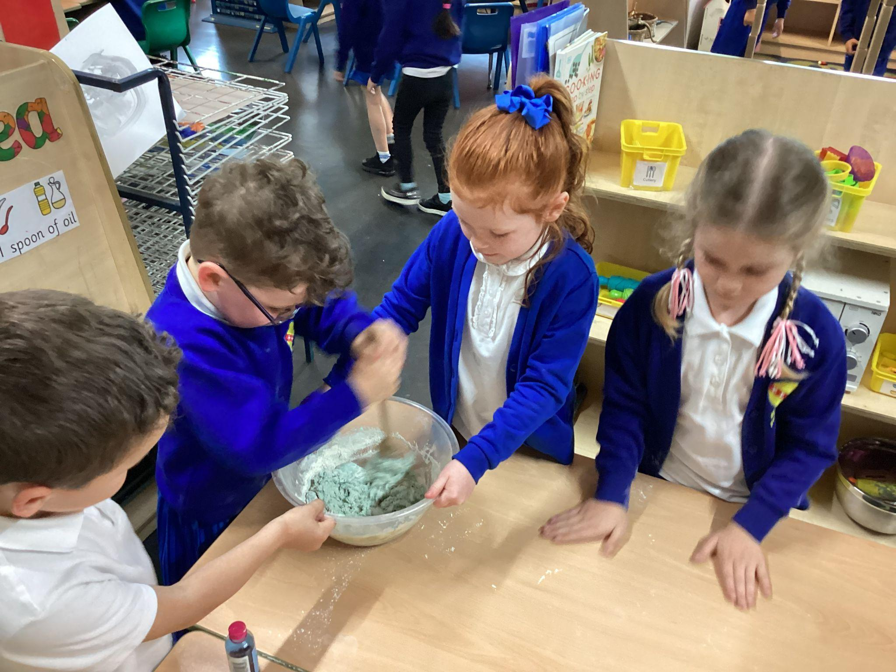
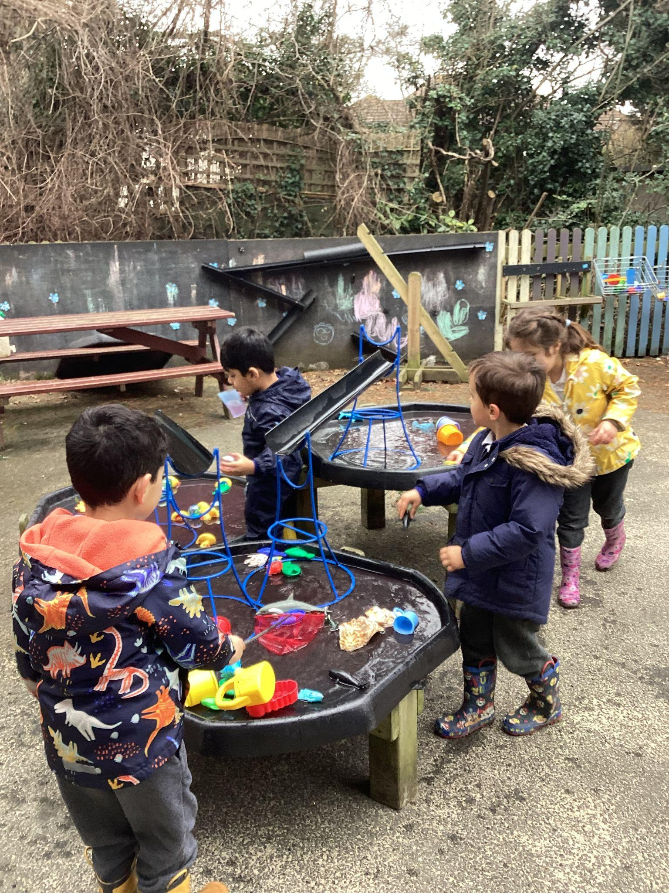
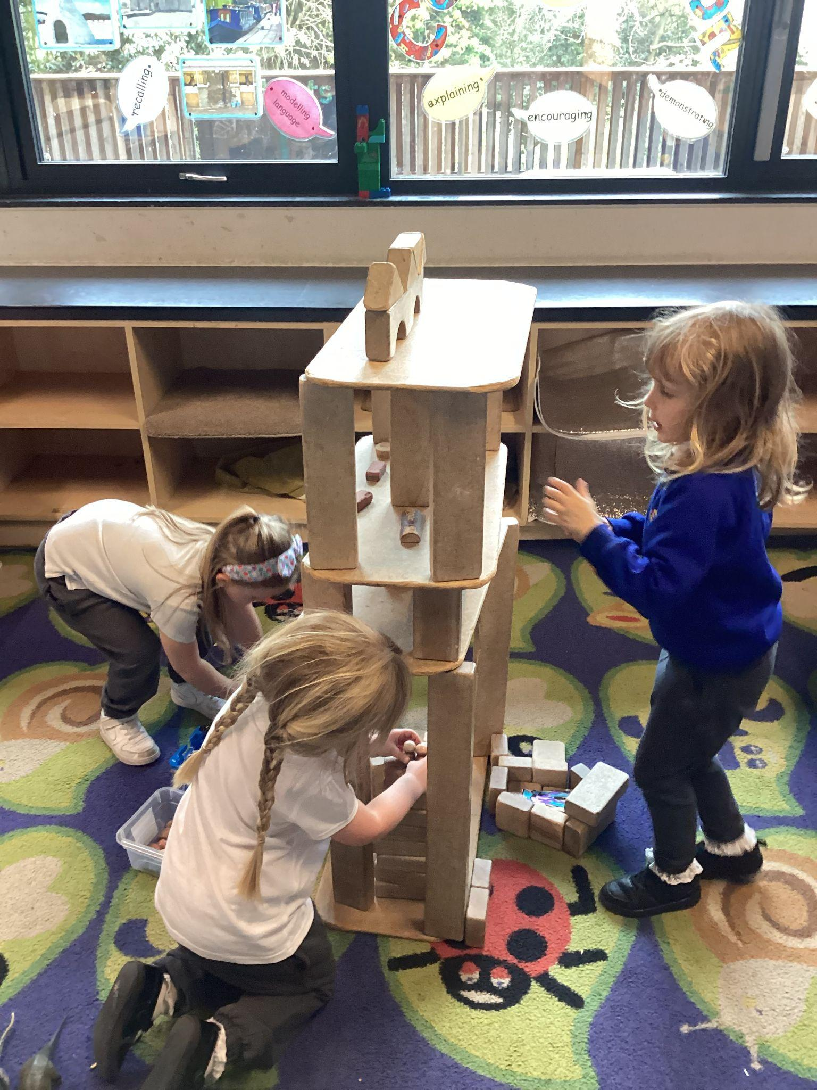
A day in Reception
At Branfil our Reception children have days packed with learning and fun!
Morning timetable:
08:35-09:00: Registration, lunch selection and daily routines
09:00-09:40: Phonics (reading)
09:45-10:50: Child initiated learning and rolling snack
10:50-11:00 Tidy up time
11:00-11:30: Maths
11:30-12:45: Lunchtime

Slide 4
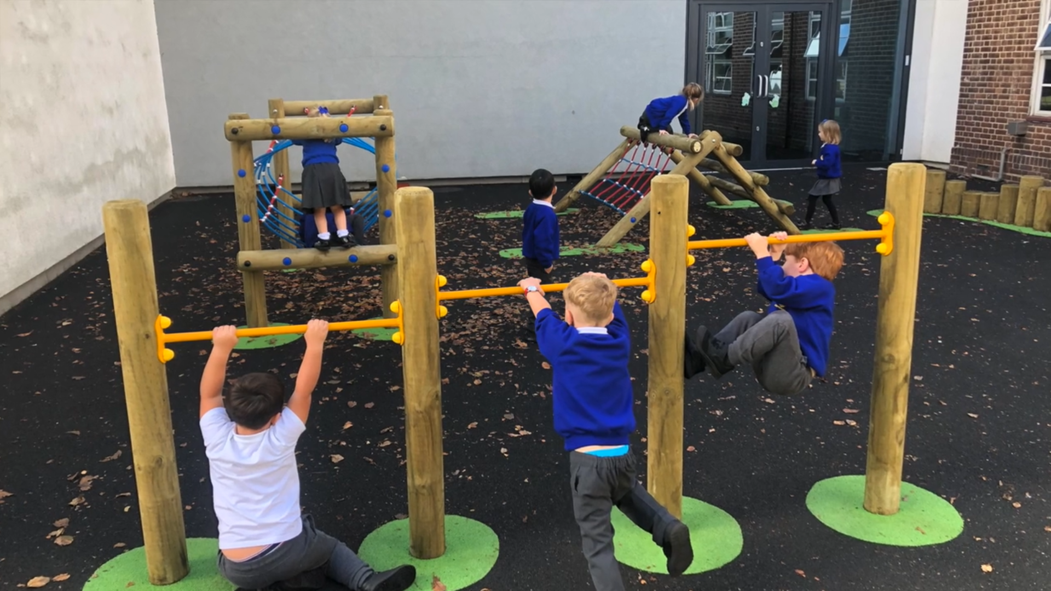
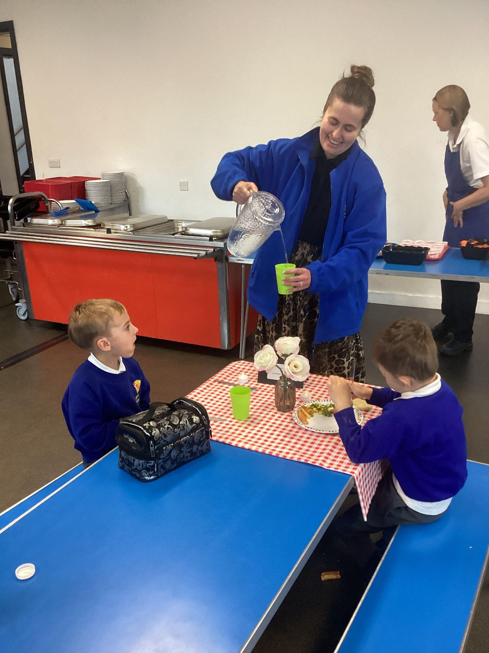
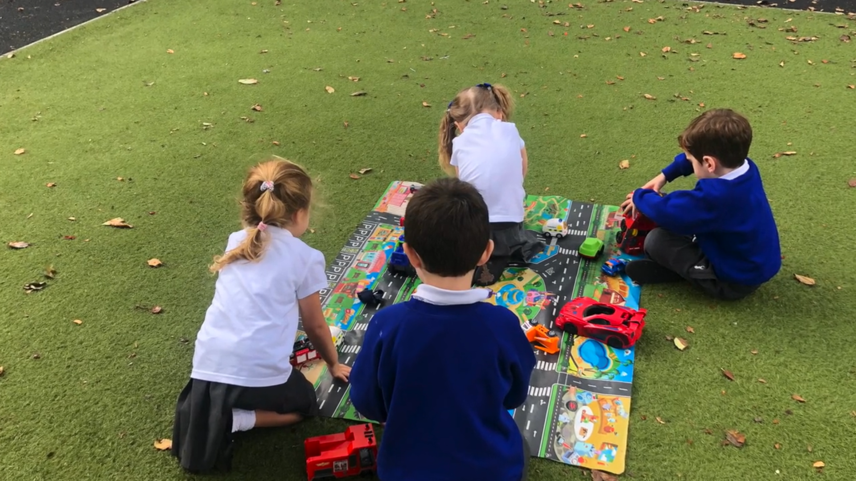
Lunch Time

Slide 5
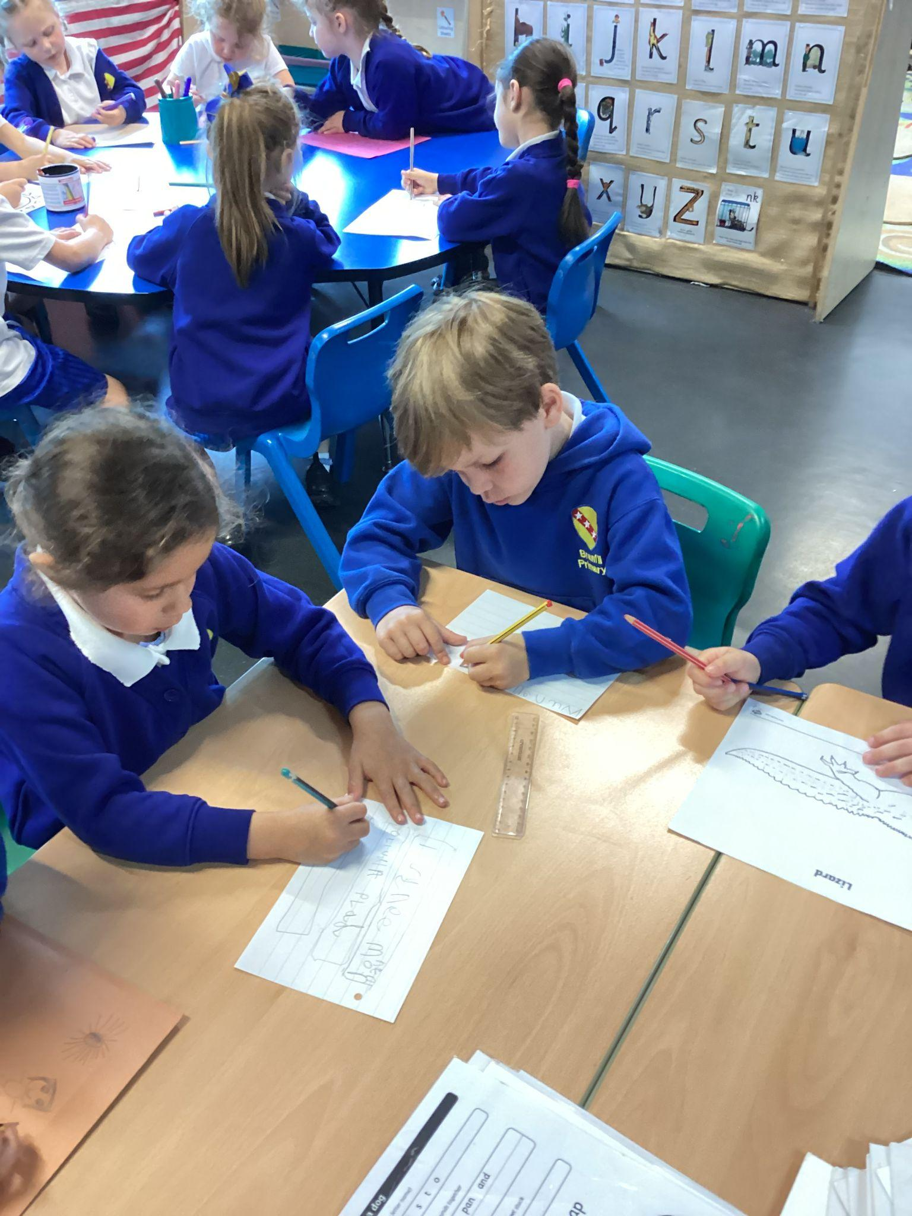
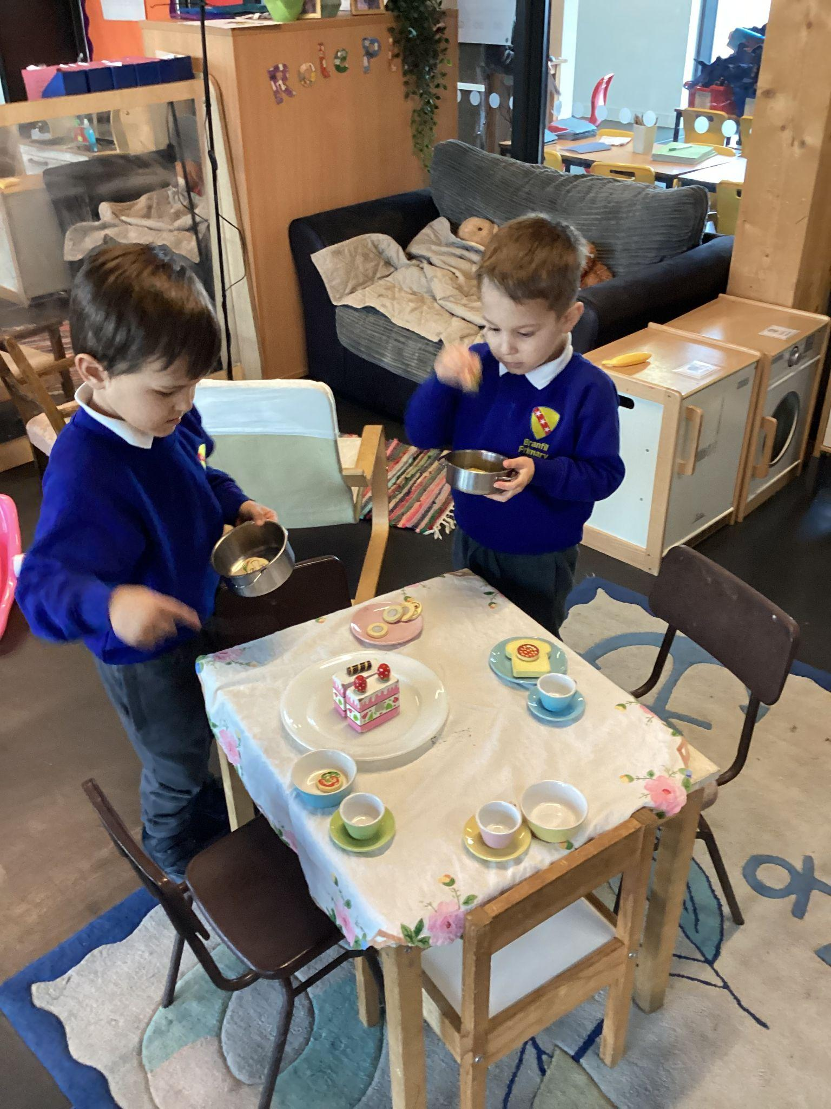
A day in Reception
At Branfil our Reception children have days packed with learning and fun!
Afternoon timetable:
12:30-12:45: Small group work
12:45-1:00: Register and songs
1:00-1:20: Story scribing, handwriting and focus child share
1:20-2:30: Child initiated learning - inside and outside
2:30-2:40: Tidy up time
2:40-2:45: Children share their work from the day
2:45-3:10: Story time and getting ready for home time
3:10 Home time

Slide 6
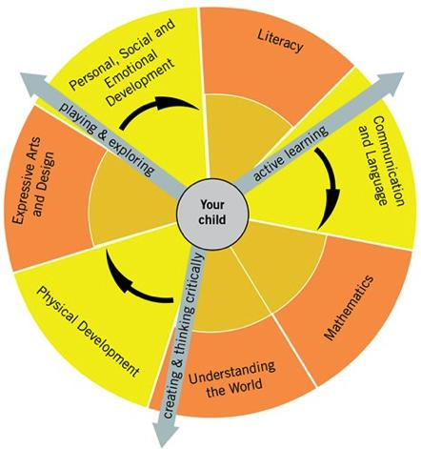
Curriculum – Areas of Learning
Prime Areas:
Communication and Language
Physical Development
Personal, Social and Emotional
Development
Specific Areas: Literacy
Maths
Understanding the World
Expressive Arts and Design
Characteristics of Effective Learning:
Playing and Exploring
Active Learning
Creating and Thinking Critically

Slide 7
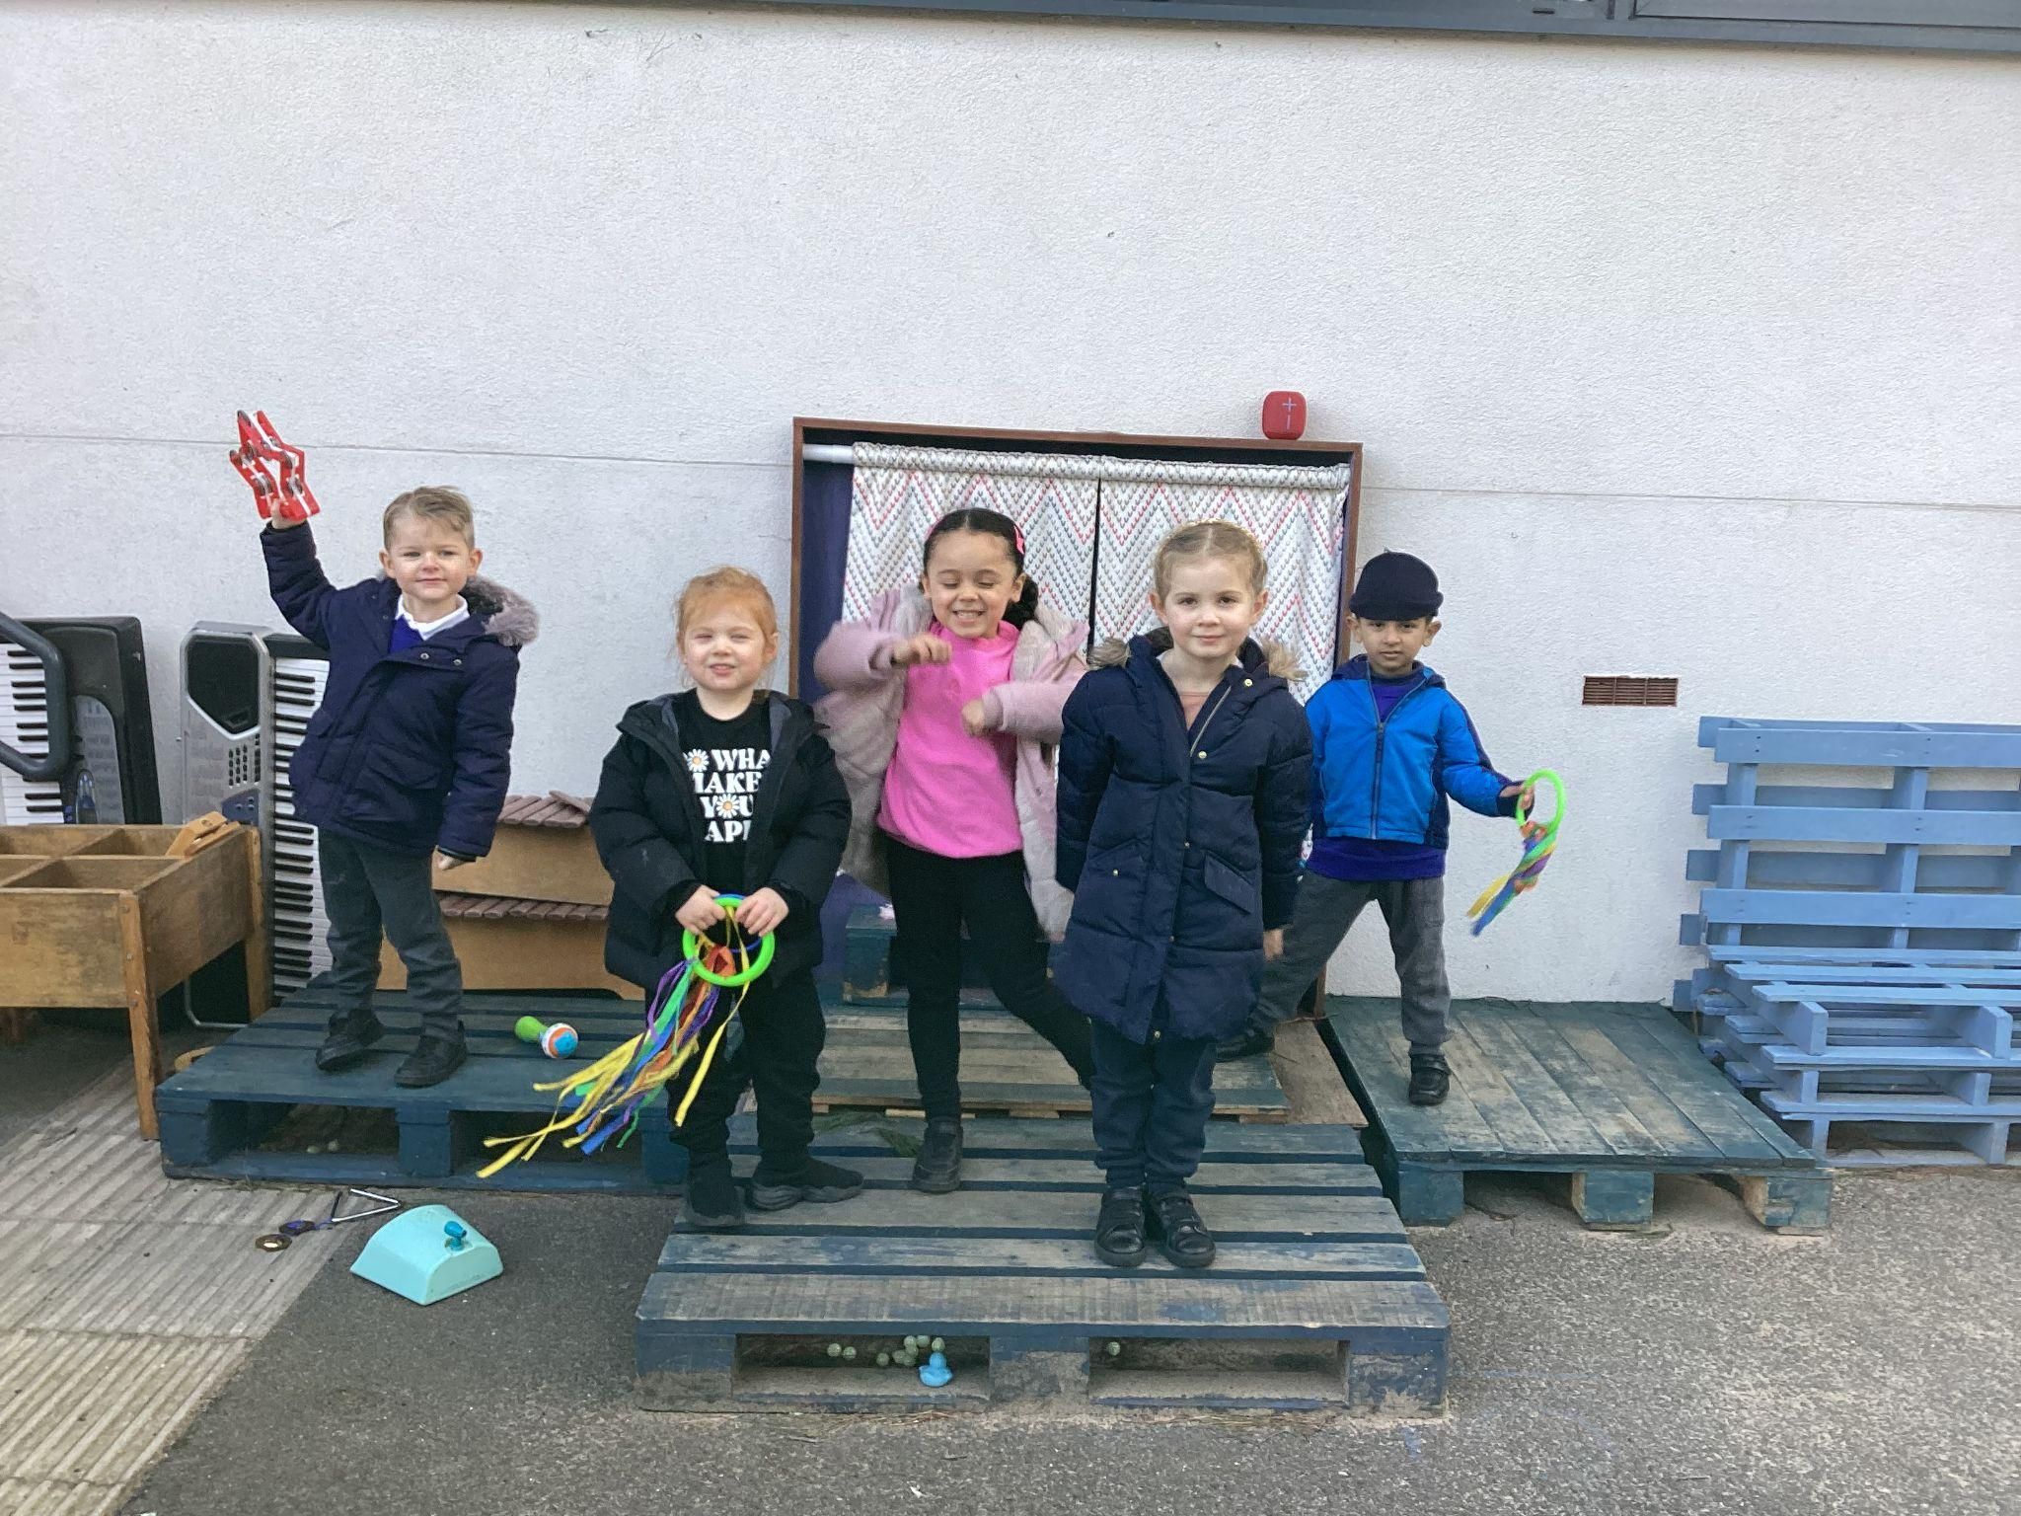
In the moment planning and child initiated learning
Focus children
One week each term
Gather and share information from home
Observe and interact with the child closely during the week
Feedback during the following week and set areas of development
Two termly face to face meeting will replace the ‘All About your Child’ meeting that the older children in the school have.
You can still contact your child’s class teacher between focus cycles through email or arrange a face to face meeting where appropriate.

Slide 8
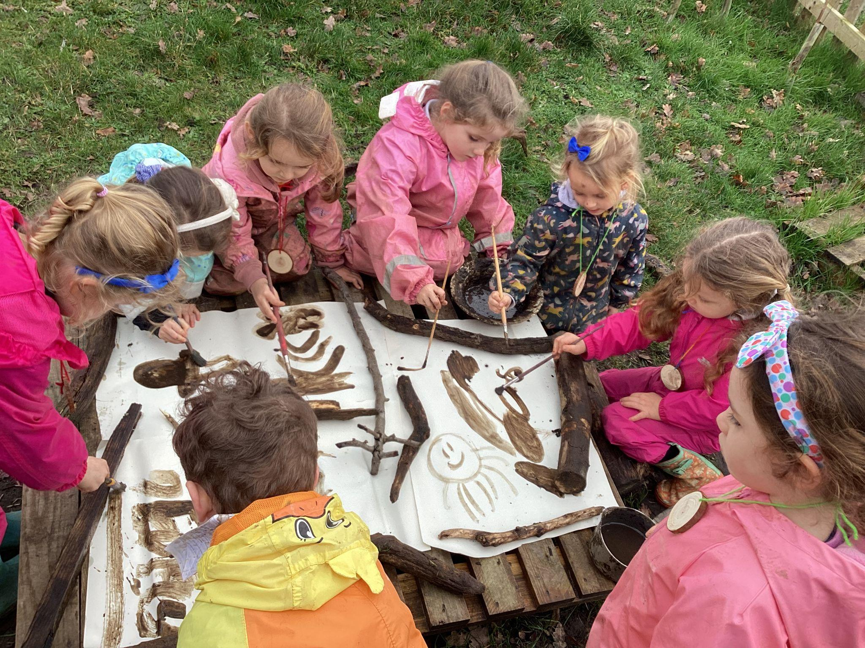
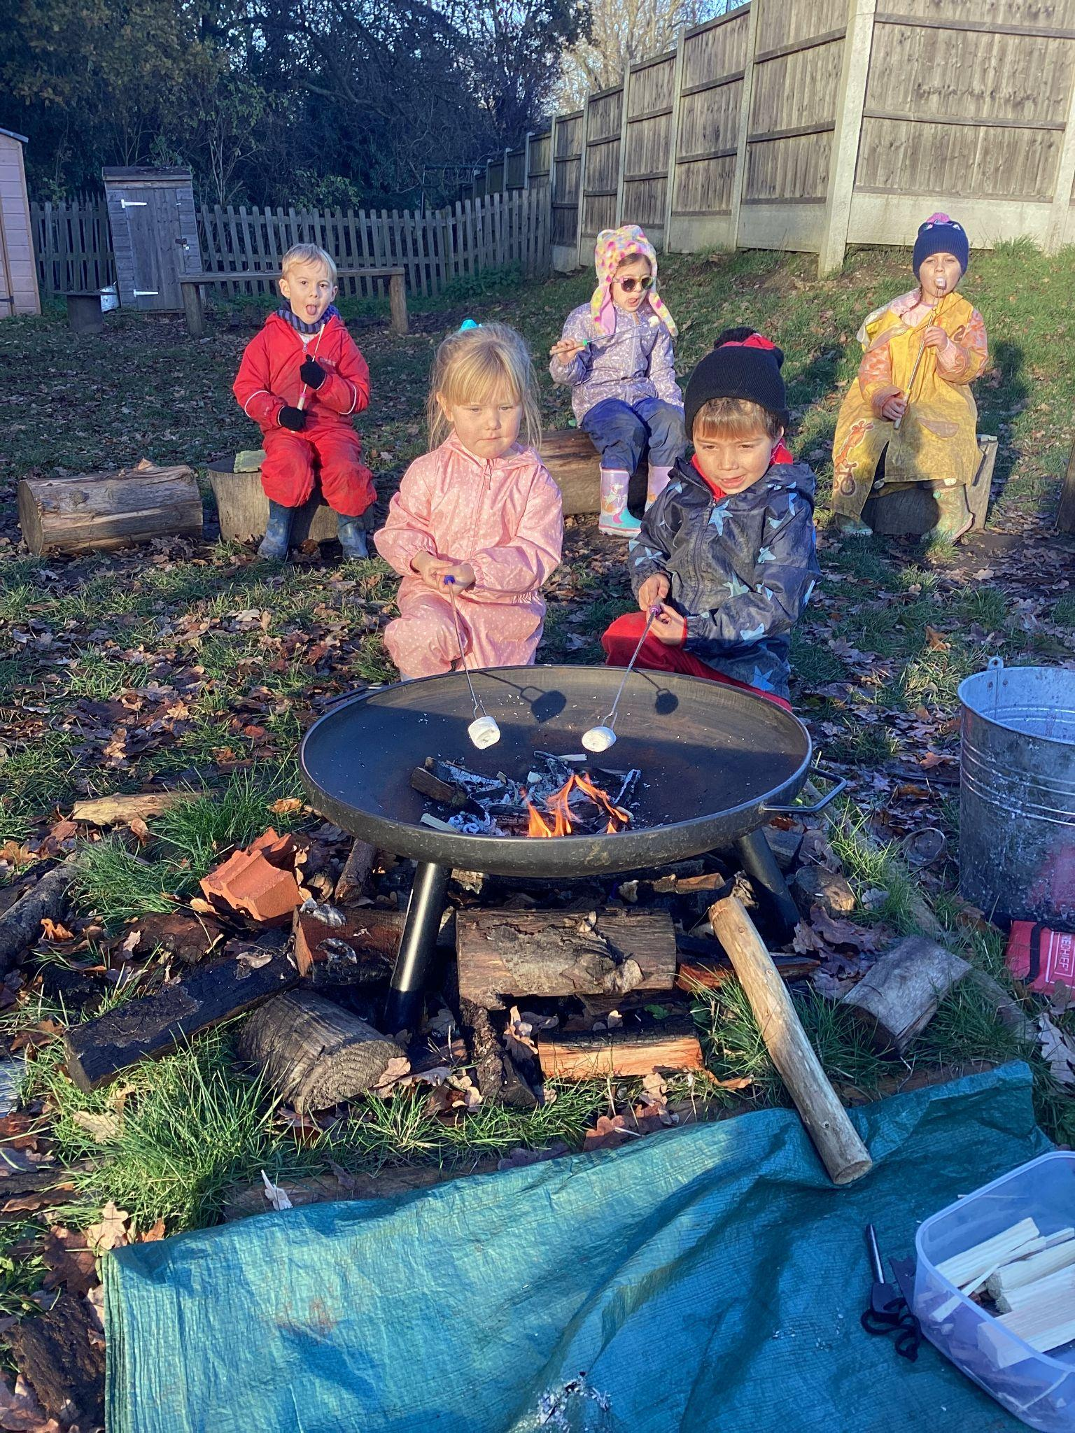
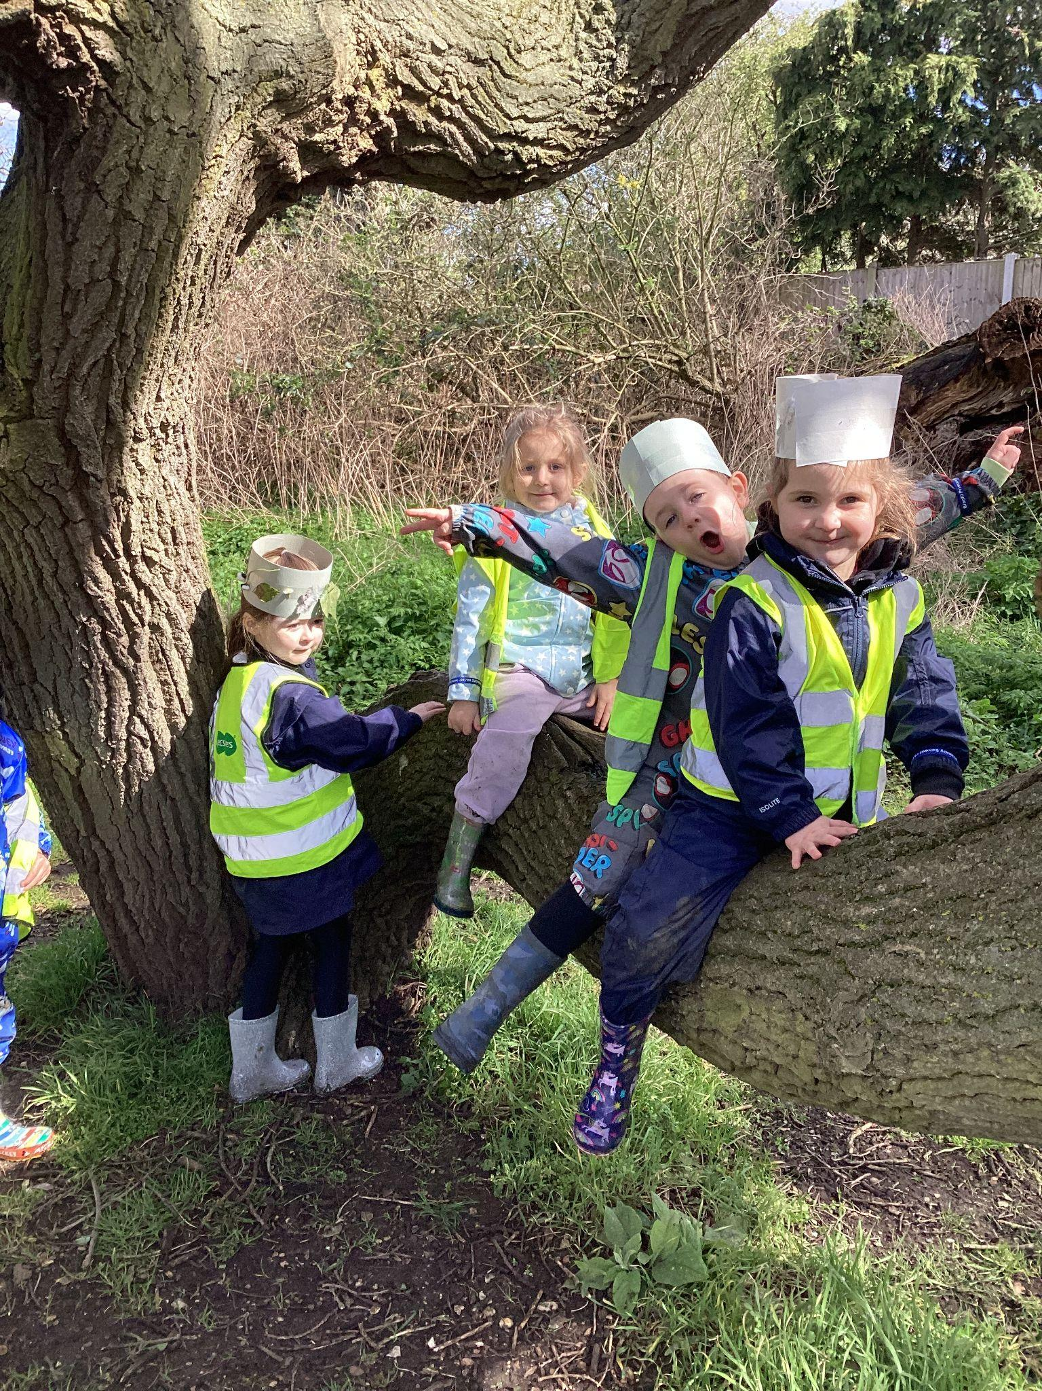
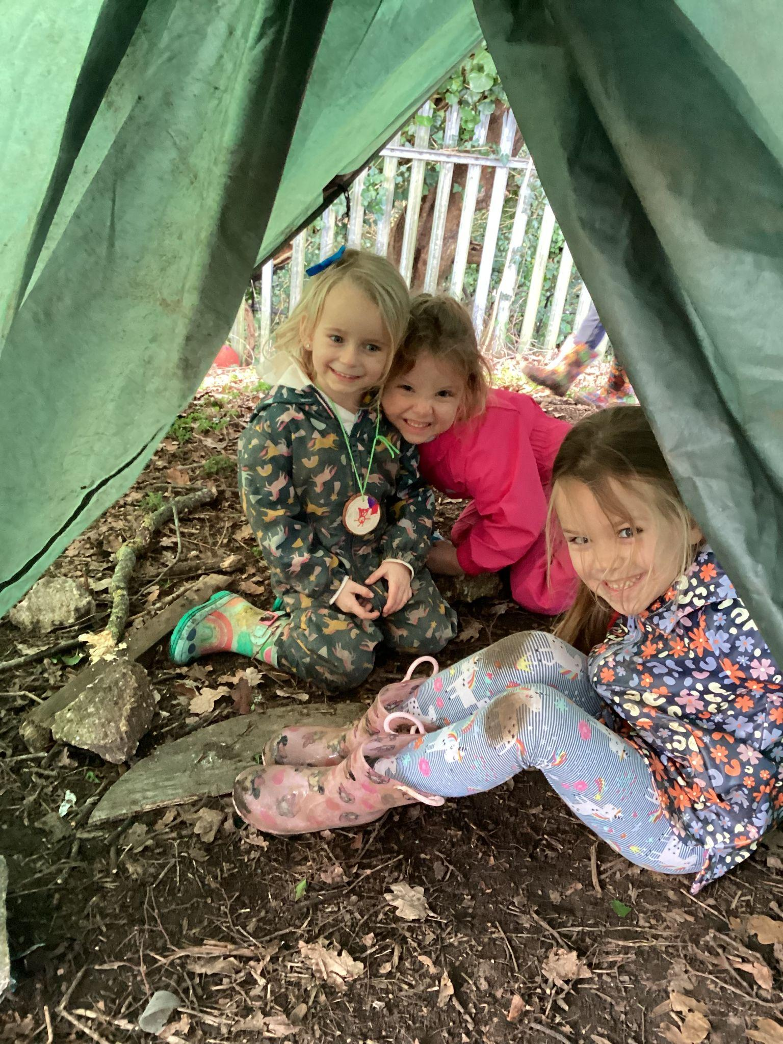
Forest School
Participate in two cycles throughout the year
Children wear suitable Forest School clothing on the day of their session; a spare change of clothes is required to be kept in school during your child’s Forest School cycle

Slide 9
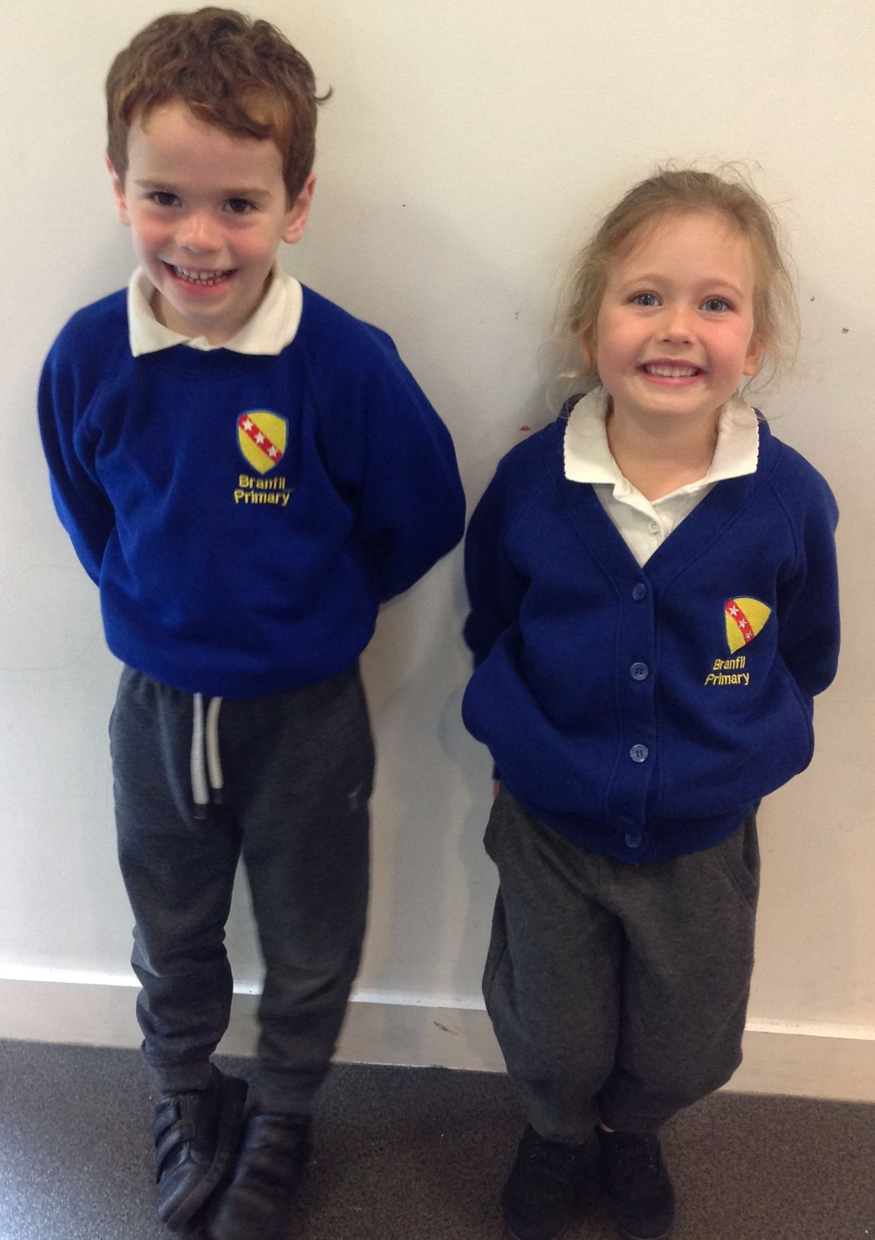
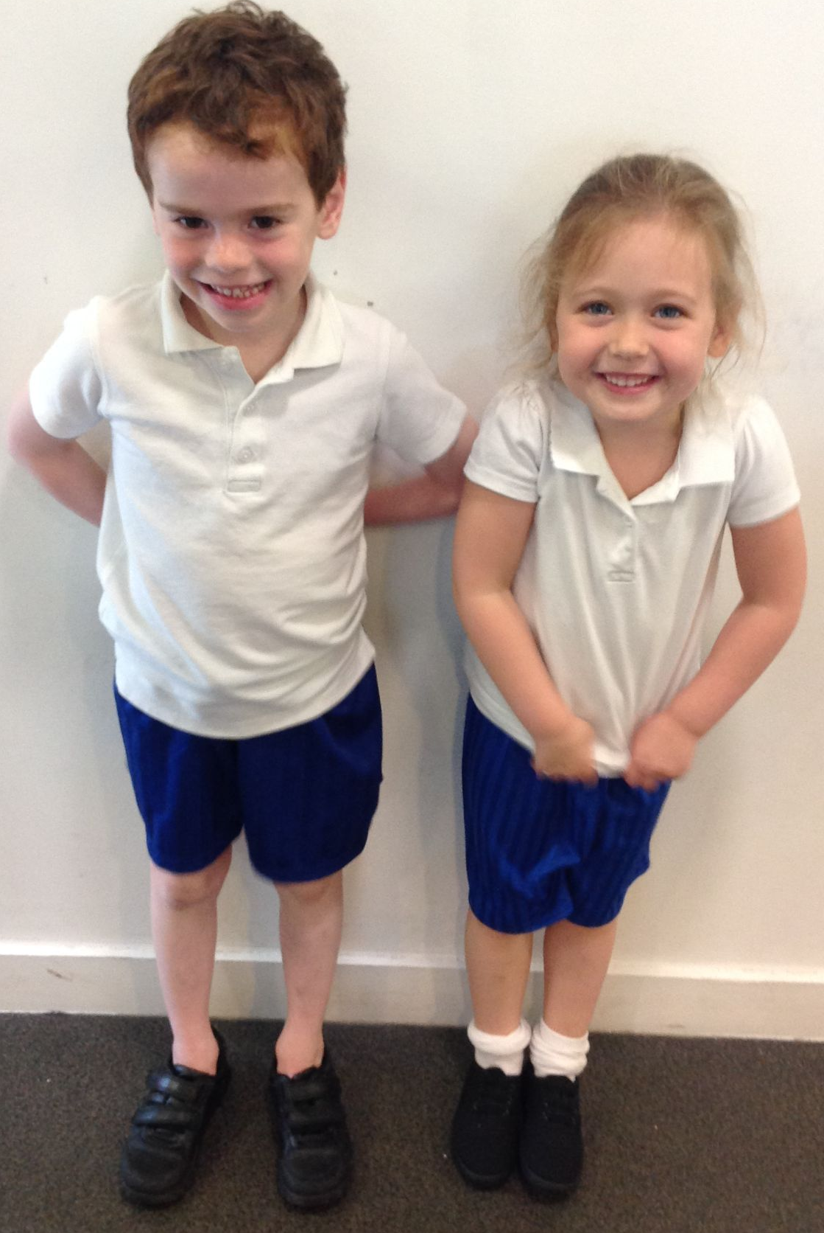
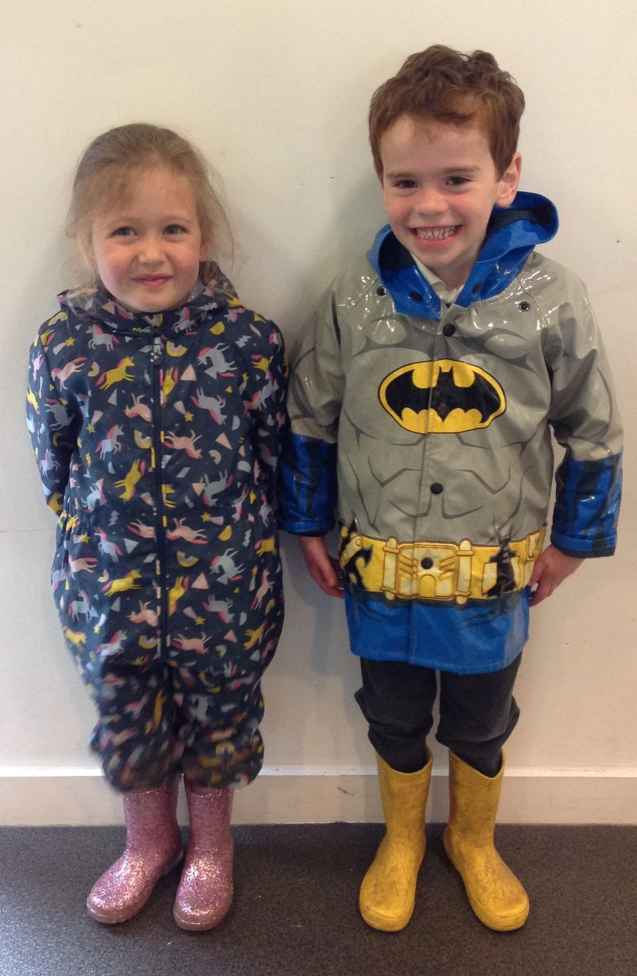
Uniform & PE Kit
Uniform can be bought at Havering School Wear, situated down Hornchurch Road. Website: http://www.haveringschoolwear.co.uk/

Slide 10
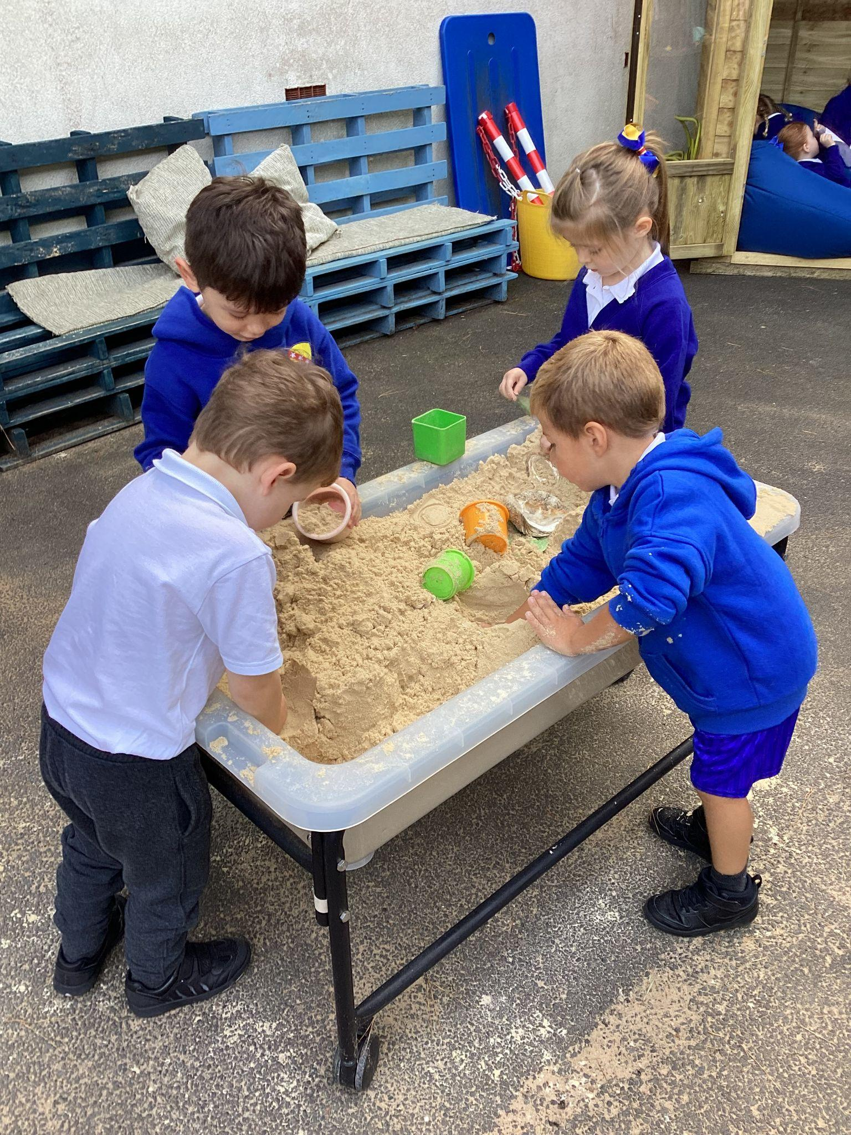
Play sessions:
There will be two play sessions for your child and one adult family member to attend:
Monday 10th June, where you will stay with your child and they can explore the environment
Monday 24th June, where you will learn some more information from Havering catering services, the school nurse, the Educational Welfare Officer, and Abacus the wrap around care provider.
Please look out for emails from this email address:
newintake2024@branfil.havering.sch.uk. We will send you information about your child’s home visit appointment, group and class and by Monday 19th July.

Slide 11
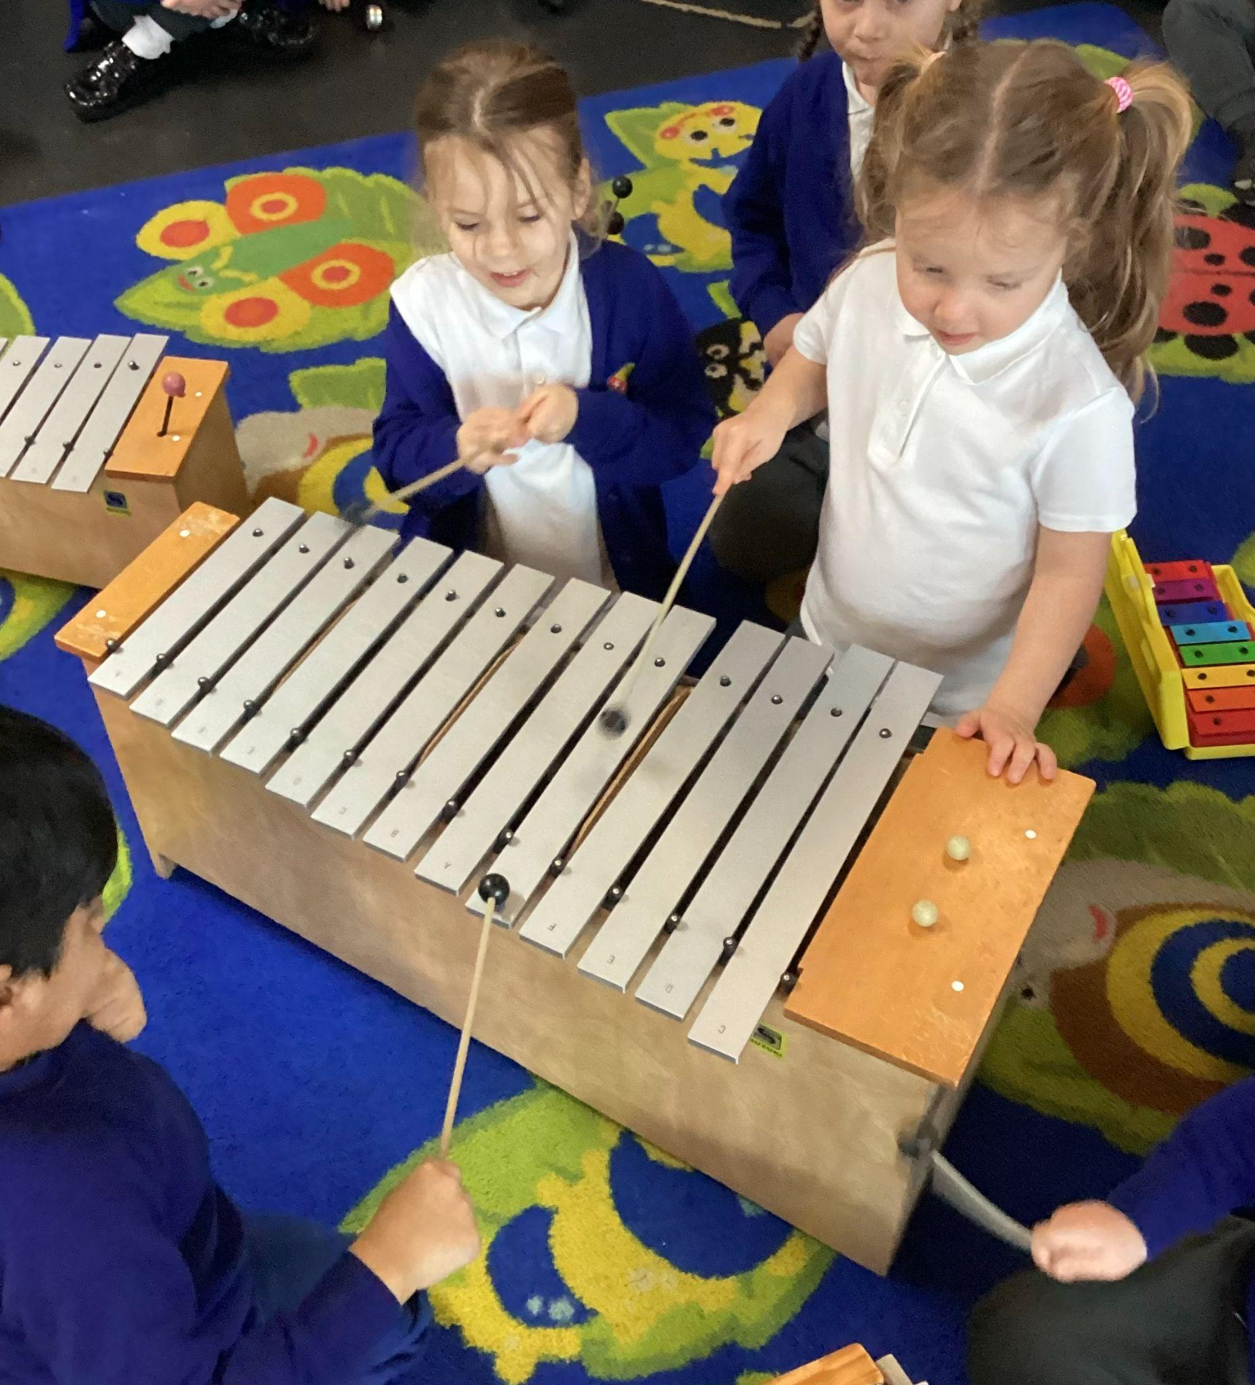
Preparing your child for school:
It can be an adjustment for parents and carers as well as children
Get them excited - talk positively about school
Teach them self care skills
Encourage independence and decision making
Read to them often

Slide 13
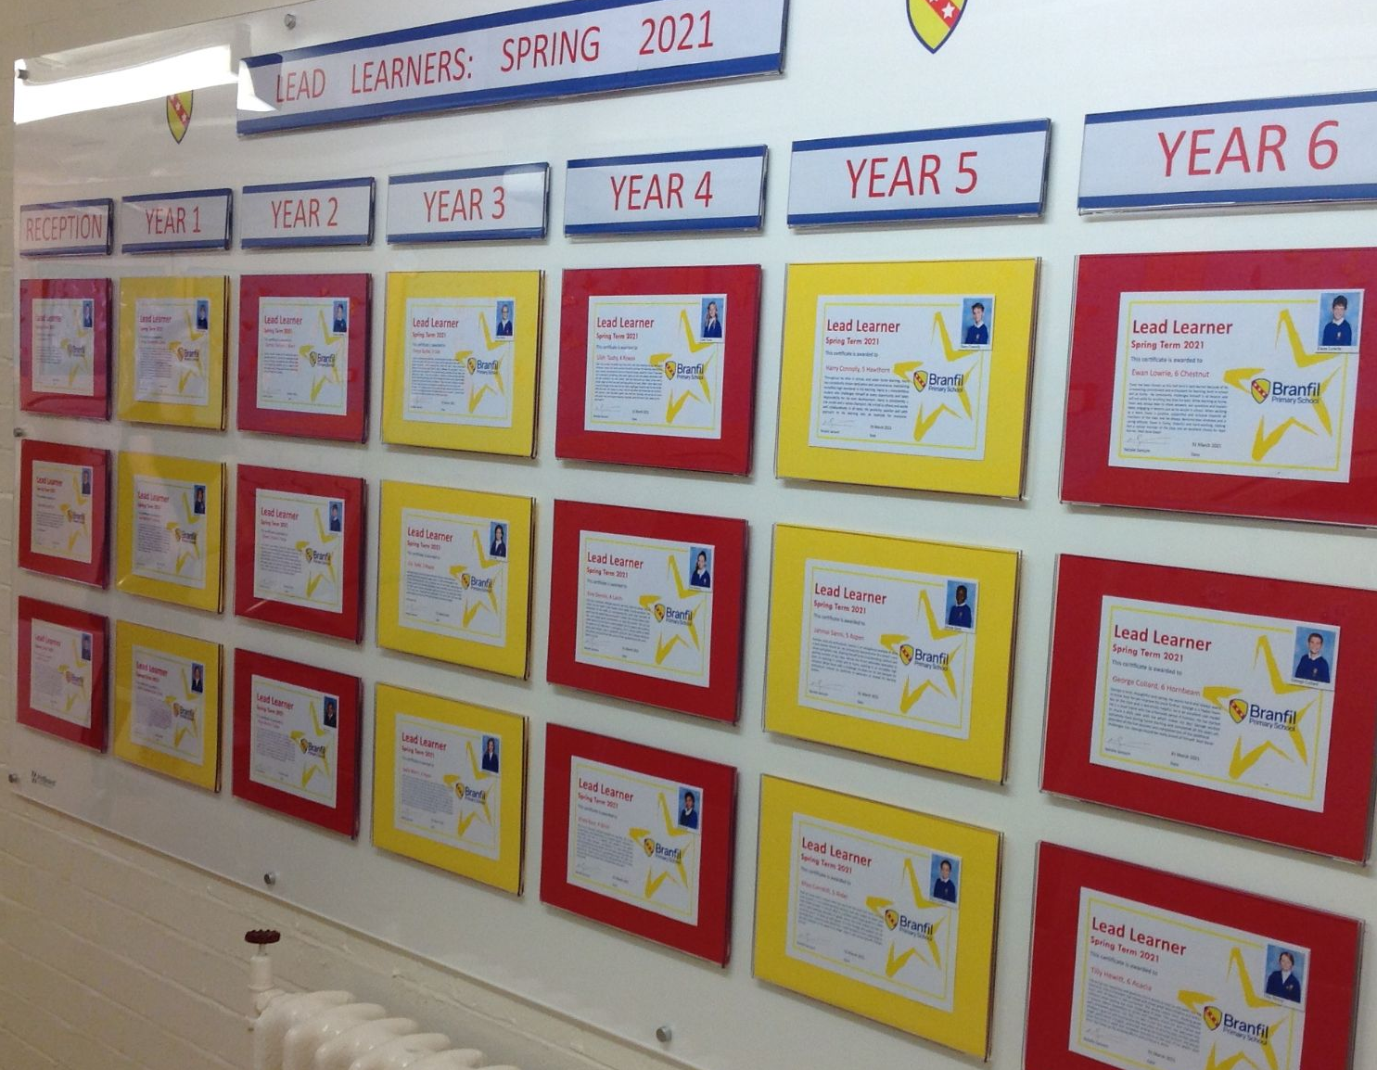

Slide 14
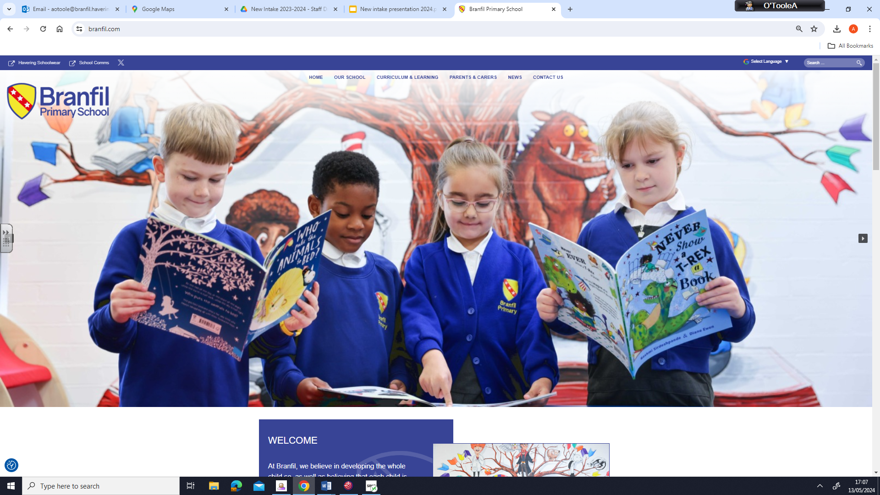
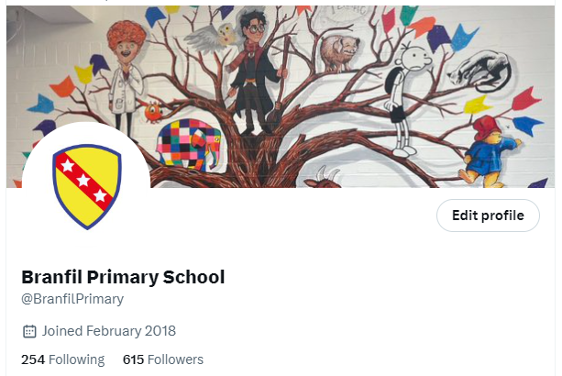
Have you visited our school website? www.branfil.com
Here you can keep up to date with exciting things happening at school, letters, news, information about year groups, subjects and the curriculum.
School X account:
@BranfilPrimary

Slide 15
From all of us here at Branfil, we look forward to seeing you and your children at our play sessions.
If you have any questions or would like any further information please email newintake2024@branfil.havering.sch.uk
Thank you

